Slide 1


Reducing Chronic Absence in
K-12 Education
Implications for Health Providers
SEHAC May 20, 2016 www.attendanceworks.org

Slide 2

About Us
Attendance Works is a national and state initiative that promotes awareness of the important role that school attendance plays in achieving academic success starting with school entry. We are an implementation partner for attendance with the Campaign for Grade Level Reading.
Our three focus areas to improve student attendance are:
              Build public awareness and political will
      Foster state campaigns
      Encourage local practice
www.attendanceworks.org

Slide 3
What does Attendance Matter: From a health perspective
Poor health and undiagnosed conditions can cause too many absences: Even when absences are excused, missing too much school can lead children to fall behind. Challenges related to poor physical, dental and mental health are leading reasons students miss too much school.
Successful learners are healthier adults: Showing up to school is essential to higher levels of academic achievement, which are associated with lower incidence of disease and longer lives for adults.
Health providers are uniquely positioned to address chronic absence: They are especially crucial allies for conveying the importance of avoiding unnecessary absences. They can use their knowledge to identify and develop solutions when health-related barriers are causing significant absences.

Slide 4

What is Chronic Absence?
Chronic absence is missing so much school for any reason that a student is academically at risk. Attendance Works recommends defining it as missing 10% or more of school for any reason.
Chronic
Absence
Excused
absences
Unexcused absences
Suspensions
Chronic absence is different from truancy (unexcused absences only) or average daily attendance (how many students show up to school each day).

Slide 5
Know your attendance measures.
Average Daily Attendance
How many students show up to school every day? The percent of enrolled students who attend school each day. It is used in CA to allocate funds to districts.
Who is missing school without permission? Typically refers only to unexcused absences. Each state has the authority to define truancy and when it triggers legal intervention. In CA = 3 absences or 3X late to class by 30 min without a valid excuse.
Truancy
Who is missing so much school they are academically at risk? Broadly means missing too much school for any reason -- excused, unexcused, etc. In CA, under LCFF, it is defined as missing 10% of school. OCR currently defines it as missing 15 days and will be releasing a report in Spring 2016. Chronic absence is a required reporting metric in ESSA.
Chronic
Absence

Slide 6
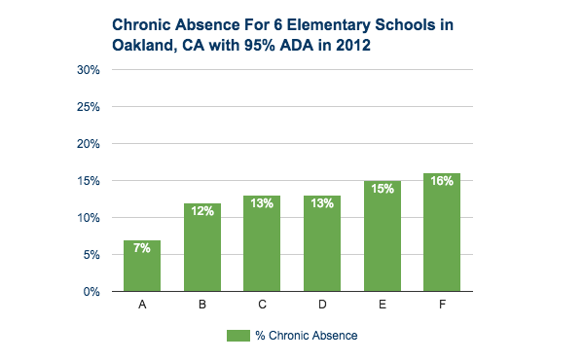
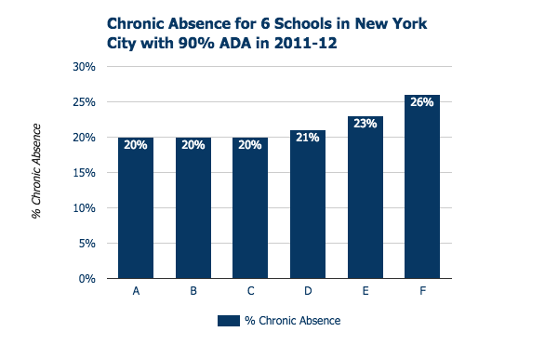
Average Daily Attendance (ADA)
Can Mask Chronic Absence
90% and even 95% ≠ A
98% ADA = little chronic absence
95% ADA = don’t know
93% ADA = significant chronic absence

Slide 7
Chronic Absence Vs. Truancy

Slide 8
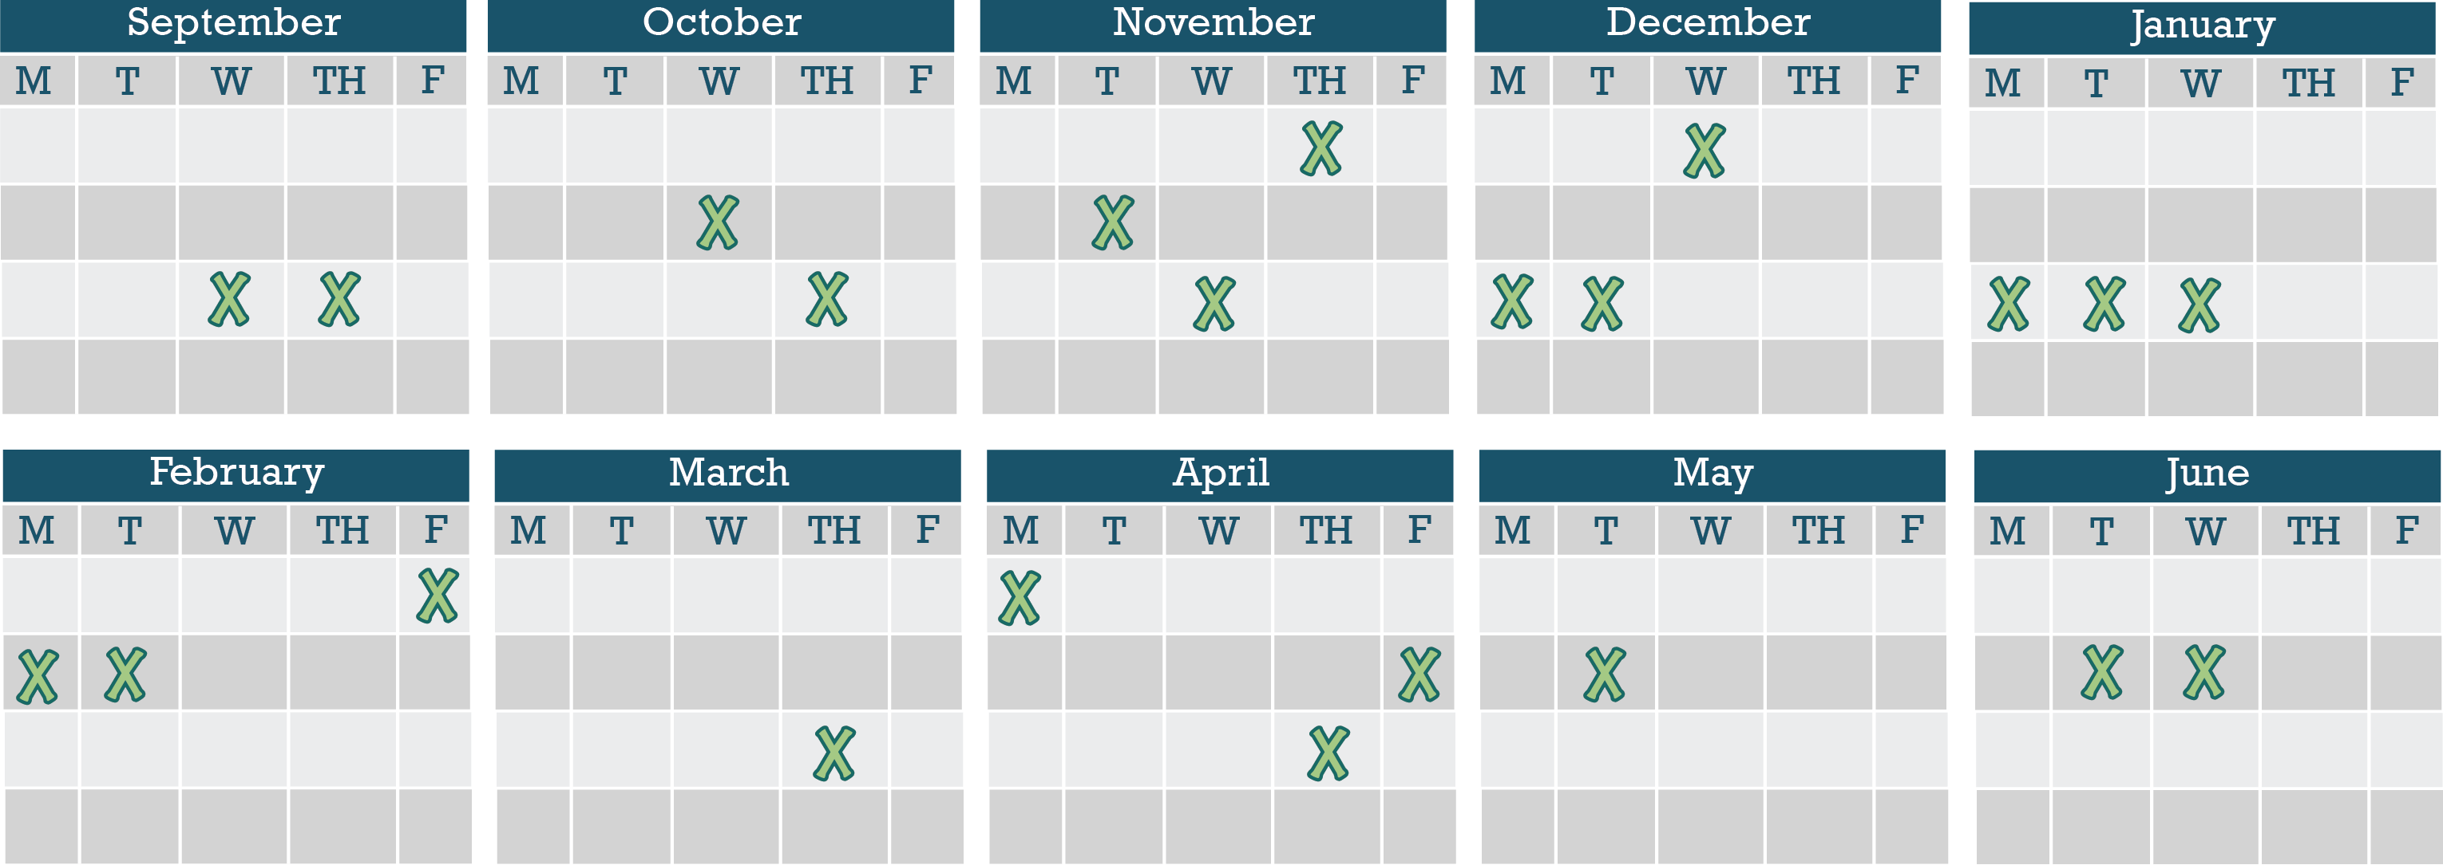
Chronic Absence Is Easily Masked If We Only Monitor Missing Consecutive days
Chronic Absence = 18 days of absence = As Few As 2 days a month
Notes:
It’s easy not to notice when your child may be missing too much school. 10% of a school year is about 18 days of absence. That sounds like a lot but when you break it down, that’s just two days a month. Most parents don’t get too stressed out if their child misses two days of class in a month. But when it happens month after month, it becomes a problem. Why?

Slide 9
Why Does Attendance Matter for Achievement?
What we know from research around the country

Slide 10

Why Does Attendance Matter?
Attainment Over Time
Achievement Every Year
Attendance Every Day
Advocacy For All
4 A School Success Framework
  Developed by Annie E. Casey Foundation & America’s Promise Alliance
  For more info go to http://www.americaspromise.org/parent-engagement-toolkit

Slide 11
Improving Attendance Matters Because it Reflects:
  Exposure to language: Starting in Pre-K, attendance equals exposure to language-rich environments especially for low-income children.
  Time on Task in Class: Students only benefit from classroom instruction if they are in class.
  On Track for Success: Chronic absence is a proven early warning sign that a student is behind in reading by 3rd grade, failing courses middle and high school, and likely to drop-out.
  College and Career Ready: Cultivating the habit of regular attendance helps students develop the persistence needed to show up every day for college and work.
  Engagement: Attendance reflects engagement in learning.
  Effective Practice: Schools, communities and families can improve attendance when they work together.
(For research, see: http://www.attendanceworks.org/research/)

Slide 12

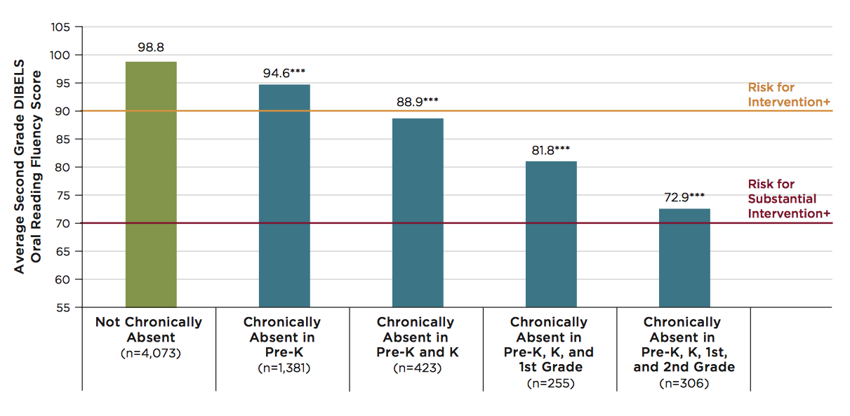

Multiple Years of Chronic Absenteeism = High Risk for low 3rd Grade Reading Skills
Note: ***Indicates that scores are significantly different from scores of students who are never chronically absent, at p<.001 level. + In the DIBELS 6th Edition Assessment and Scoring Guide (Good & Kaminksi, 2002), these are labeled as “Some Risk,” indicating the need for additional intervention and “At Risk,” indicating the need for substantial interventions.
Notes:
The impact increases with multiple years of chronic absence. Experience indicates turning chronic absence around within 2 two years leaves a reasonable opportunity for students to recuperate academically from the lost time. Three consecutive years or more of chronic absence leaves gaping deficits. For principals this puts a very high priority on preventing or abating chronic absence from the outset of schooling.

Slide 13
Chronic Early Absence Connected to Poor Long- Term Academic Outcomes
Chronic absence in kindergarten
Lower levels of
literacy in first grade
Lower achievement as far out as fifth grade
A Rhode Island Data Hub analysis found that compared to kindergartners who attend regularly, those chronically absent:
Scored 20% lower in reading and math in later grades and gap grows
2X as likely to be retained in grade.
2X likely to be suspended by the end of 7th grade.
Likely to continue being chronically absent
Notes:
Chronic early absence is the percentage of children in grades K-3 that miss 10% or more of the school year (or 18+ days in a 180-day school year).
Research shows that children who are chronically absent in kindergarten
Show lower levels of literacy in 1st grade
AND that chronic absence in kindergarten can predict lower achievement as far out as the 5th grade.
It is easy to overlook the prevalence of chronic early absence and think you don’t have an attendance problem if you only look at average daily attendance.
BUT in 2012, Rhode Island’s 4 core cities had an average daily attendance rate of 94%, BUT almost 1 in 5 students (19%) were chronically absent.
Chronic early absence can be reduced by using data to regularly identify and intervene with students who have multiple absences, engaging, educating and providing supports for families, personalizing the educational experience for all students, and educating communities to support school attendance.

Slide 14

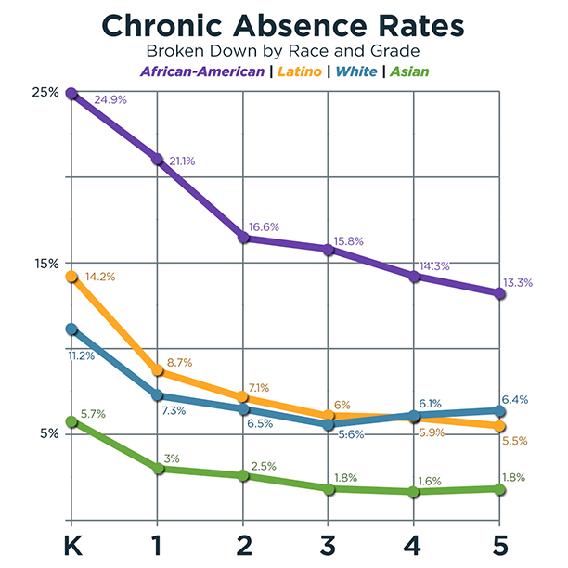
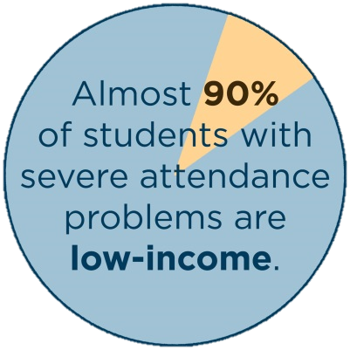
CA Data Shows Vulnerable Children Have Higher Levels of Early Chronic Absence

Slide 15
Chronic absence is especially challenging for low-income children
Poor children are 4x more likely to be chronically absent in K than their highest income peers.
Children in poverty are more likely to lack basic health and safety supports (health care, transportation, stable housing, food, clothes, etc.) that ensure a child is more likely to get to school.
The adverse impact of absenteeism on literacy development is 75% greater for these children than for their middle class peers.
* (Romero & Lee 2007)

Slide 16
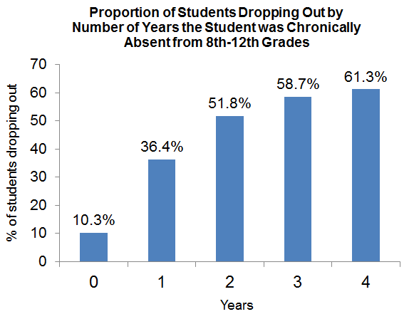
The Effects of Chronic Absence on Dropout Rates Are Cumulative
Proportion of Students Dropping Out by Number of Years the Student was Chronically Absent from 8th-12th Grades
http://www.utahdataalliance.org/downloads/ChronicAbsenteeismResearchBrief.pdf

Slide 17
How Can We Address Chronic Absence?

Slide 18
Shifting Paradigm on Attendance
Truancy
Counts unexcused absences
Emphasizes compliance with school rules
Uses punitive, legal solutions
Chronic Absence
Counts all absences
Emphasizes academic impact of missed days.
Uses preventive strategies, positive messaging

Slide 19
Who Makes a Difference?
Children: When they get excited about coming to preschool every day and convey that enthusiasm to their parents and caregivers.
Families: When they understand that absences matter, feel welcome and respected, value their children’s attendance and seek help as needed to overcome barriers.
School Staff: When they create a positive school experience and build attendance messaging, tracking, problem-solving and celebrating into preschool routine.
Community: When partners reinforce messaging and provide resources to help families overcome barriers to attendance.

Slide 20
Unpack contributing factors to chronic absence
Myths
Absences are only a problem if they are unexcused
Sporadic versus consecutive absences aren’t a problem
Barriers
Lack of access to health or dental care
Aversion
Child struggling academically or socially
Bullying
Attendance only matters in the older grades
Poor Transportation
Trauma
No safe path to school
Ineffective school discipline
Parents had negative school experience
Disengagement
Lack of engaging and relevant instruction
No meaningful relationships with adults in school
Vulnerable to being with peers out of school vs. in school
Poor school climate
Undiagnosed disability
Homelessness

Slide 21
Leading Health Related Causes
Asthma
Nutrition
Mental Health
Oral Health
Bullying
Vision
Notes:
Of course, the problem of health-related chronic absence goes far beyond these two issues. Research indicates that other common health conditions resulting in missed school include bullying, mental health, nutrition and vision. Let me walk through some quick details here because it’s quite sobering:
Bullying: over 7% of students report not going to school at least one day in the previous month because they felt unsafe at school or on the way to school.
Nutrition: Children who come from food-insecure home are more likely to be suspended from school and have higher rates of absenteeism. And obese students are 1.7 times more likely to have 10 or more absences in a given year than their non-obese peers.
Mental Health: Children affected by ADHD are more likely to exhibit tardiness and absenteeism.
Vision: Students with vision impairments are at increased risk of disengagement from school which is a risk factor for increased missed school days.
Compounding the problem is the fact that many schools do not provide conditions that support student health. Many schools have inadequate school nurse staffing, poor indoor air quality, or a lack of access to physical activity – all which can contribute to health issues.
Of course the health-related factors don’t end with this list, but the message is clear, addressing health, particularly in a young populations, need to be part of a strategy to address chronic absenteeism.

Slide 22
Leading Health Related Causes
Asthma
Oral Health
Nearly one in ten children age 4-14 are diagnosed with asthma accounting for one-third of all days of missed instruction.
Children miss nearly two million school days due to oral health issues every year.
Notes:
But, as the leading health-related causes of chronic absenteeism, the examples of asthma and oral health illustrate the tremendous scale of this problem:
Asthma. Nearly one in 10 children (9.9 percent) age 4-14 are diagnosed with asthma. Asthma is a leading cause of school absenteeism, accounting for one-third of all days of missed instruction. Children with persistent asthma are more than three times as likely to have 10 or more absences than their peers.
Oral health. A full twenty percent of children aged 5 to 11 years have at least one untreated decayed tooth. Among school-age children, tooth decay is the most common chronic disease, five times more prevalent than asthma. Children between 5 and 17 years miss nearly two million school days in a single year nationwide due to dental health-related problems. Children with poor oral health status are nearly three times more likely than their counterparts to miss school as a result of dental pain.

Slide 23
Asthma and Attendance in Oakland
In 2011-12, OUSD students diagnosed with asthma had higher rates of chronic absence:
 | % Students Diagnosed with Asthma who were chronically absent | % Students not Diagnosed with Asthma who were chronically absent
Overall | 17% | 11%
African American | 23% | 17%
Latino | 12% | 9%
Pacific Islander | 47% | 23%
White | 10% | 4%
Notes:
Higher rates of asthma diagnoses tend to be found in schools and neighborhoods (such as West Oakland) located closer to freeways, the Port of Oakland, and industrial areas of Oakland.
And there are extremely high levels of chronic absence overall – starting in the early grades – among African American students. These are the same students who live in violent, environmentally hazardous neighborhoods. Health challenges could be contributing to these higher levels.

Slide 24
Health Interventions
Asthma
Asthma friendly schools
Environmental assessments
Asthma friendly homes
Nutrition
Community eligibility
Universal breakfast
Food backpack programs
Farm to school programs
Mental Health
School-based mental health programs
Universal interventions
Screening, Brief Intervention and Referral to Treatment
Oral Health
Community –based oral health programs
School-based sealant programs
Mobile clinics
Bullying
Safe Routes to Schools
Bullying education programs
Support groups
Vision
School-based vision screening programs
Notes:
Now, we must remember that health-related chronic absenteeism is not an inevitable fact of childhood. There is much that can be done – by the education community, by the public health community, and by the medical community – to address this issue and relieve the lifelong burden it places on young children.
And issue by issue, there are a number of existing, proven best practices that schools can use to address many of the underlying health-related causes of chronic absenteeism. The slide you are looking at includes a small sample of potential interventions. However, interventions should be informed by the needs of one’s community. The From Asthma friendly school initiatives that can reduce asthma episodes in schools, to safe routes programs addressing walkable schools, to implementation of community eligibility provisions that can provide better access to nutrition for food insecure students. These types of interventions can help provide students access to a healthier school environment - a critical step in addressing chronic absenteeism and supporting students’ lifelong wellness.

Slide 25
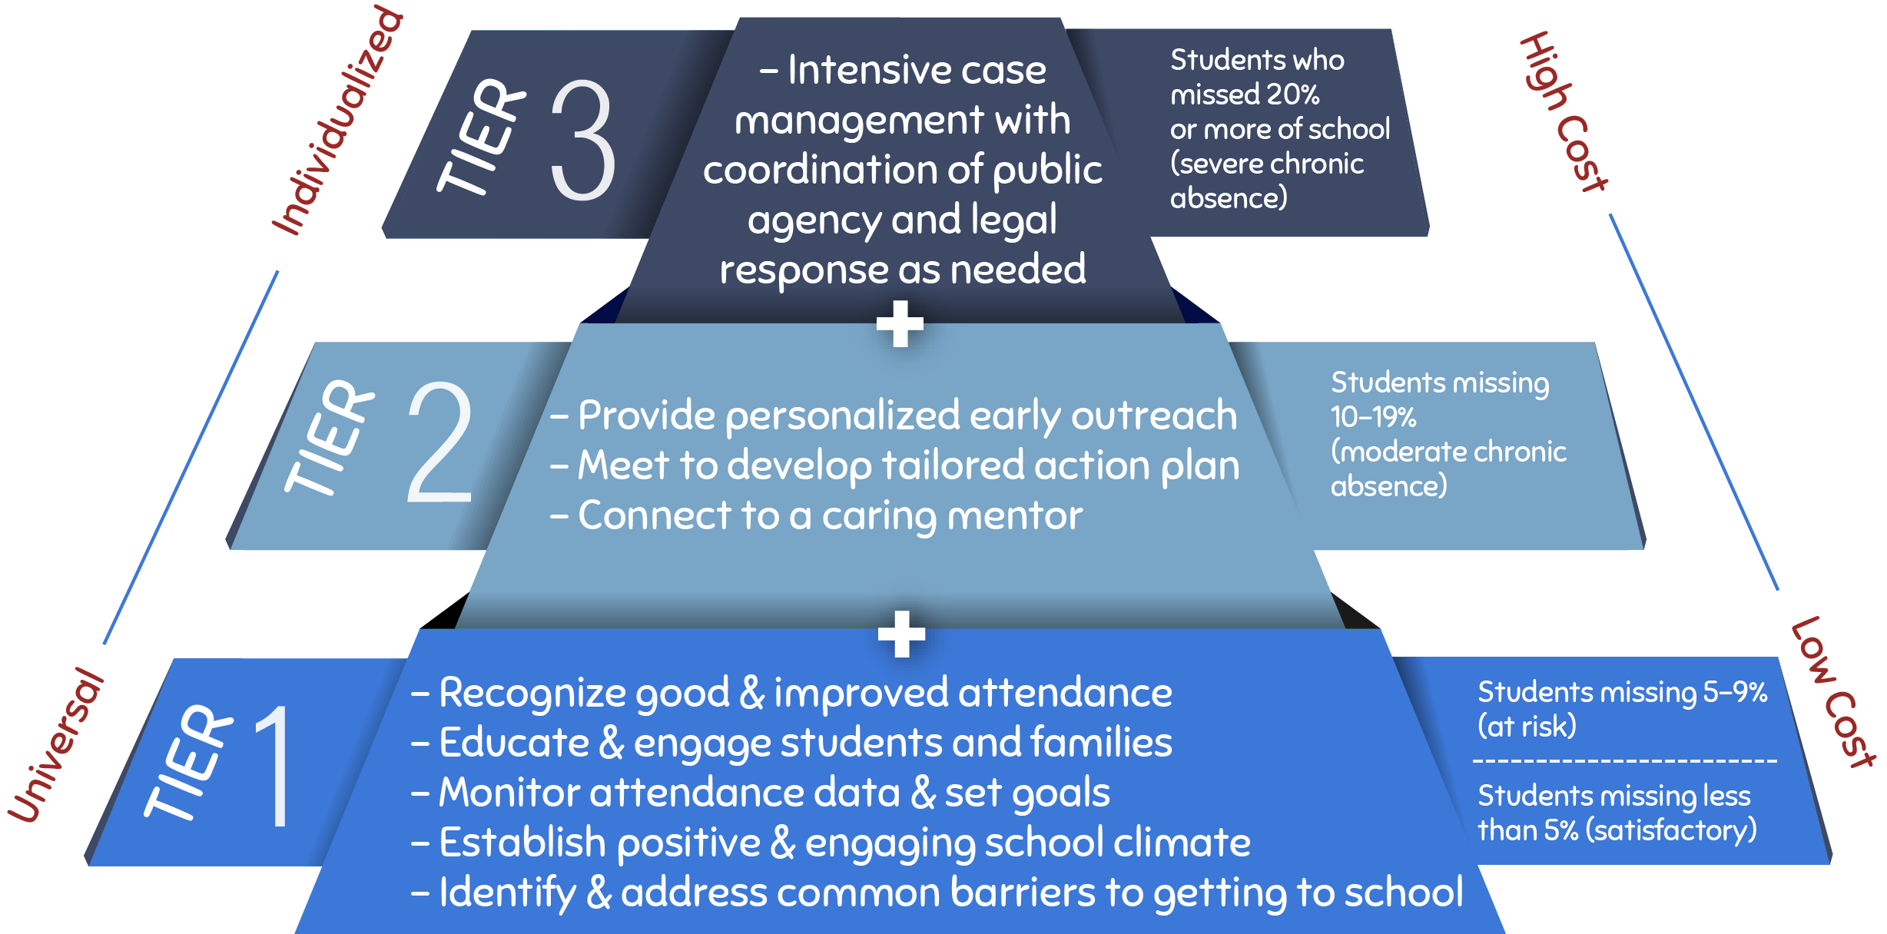
Invest in Prevention and Early Intervention

Slide 26
Tier 1: Creating a positive, engaging school climate that supports attendance
Attendance is higher when schools:
Promote a sense of belonging and connection including noticing when students show up
Make learning engaging so students don’t want to miss class Engage in restorative practice not punishment
Meet the basic needs of our most economically challenged families so all have the opportunity to get to school
Build awareness about how absences can easily add up to too much time lost in the classroom

Slide 27
Parents underestimate the number of year-end absences
Missed an average of 2+ days per month 90%
Ad Council research commissioned by AG Harris asked parents with students with a history of absence about his their children’s absences in two ways:
Was your child absent an average of 2 or more days a month?
Was your child absent more than 10 days over the year?
60% of parents said their child was absent an average of 2+ days a month, but not 10+ days a year
Missed 10+ days annually 30%
The math: If a child is absent an average of 2+ days a month, then he/she is absent far more than 10+ days a year

Slide 28
Parents More Likely to Consider Attendance a “Big Deal” in High School
% who say “it’s a big deal to miss at this grade level”
Ad Council – CA Attorney General – Parent Ethnographies 2015

Slide 29
Schools inadvertently reinforce some absence-causing beliefs
Reinforce Attendance
Class rewards for good attendance (e.g. popcorn or ice cream parties)
Reinforce Absenteeism
Impersonal letters
Individual recognition for students with good attendance
Teachers send work home in response to absences
Teachers do not address absenteeism issue with the parent
Parents do not feel their child is safe in school
High levels of absenteeism in the class
Impersonal Letters:
Easy to disregard
Many parents felt the school miscounted—but parents couldn’t verify because they weren’t tracking absences
Many parents felt that the school didn’t understand them
Sending Work Home:
Parents thought that completing a makeup packet caught their child up for the missed day’s work
Teachers Not Addressing Absenteeism:
Most parents reported that they regularly communicate with their children’s teacher, but never about absences
Big motivators for kids, but not for parents
Reinforces parents’ existing attitudes & behaviors

Slide 30

Parent Video & Discussion Guide
Bringing Attendance Home
Video (6 minutes)
Facilitated conversation
  The consequences of chronic absence
  How to improve absenteeism
    Family practice
    Increase social capital
    Identify how school can help
    Community services
http://www.attendanceworks.org/tools/for-parents/bringing-attendance-home-video

Slide 31

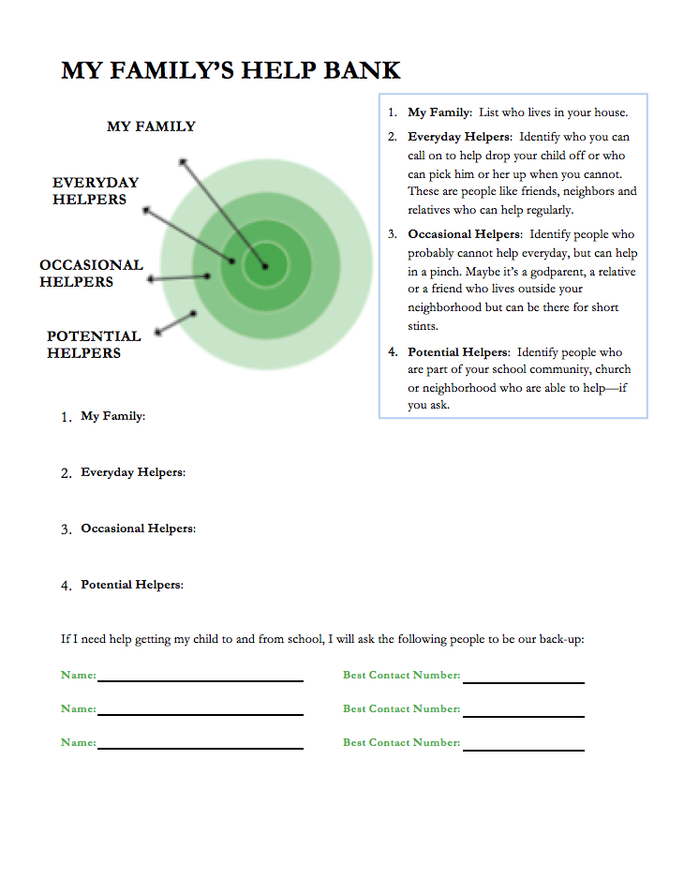

Help families make back-up plans

Slide 32
Criteria for Identifying Priority Students for Tier 2 Supports
Chronic absence (missed 10% or more of school) in the prior year, assuming data is available.
And/or starting in the beginning of the school year, student has:
In first 2 weeks
2 absences
In first month (4 weeks)
2-3 absences
Missing 10% any time after
In first 2 months (8 weeks)
4 absences

Slide 33
The first month of school predicts chronic absence
Baltimore students who missed 2-4 days of school in September were 5 times as likely to be chronically absent.
Students who missed 5 or more days of school in September were 16 times as likely to be chronically absent.

Slide 34
Possible Tier 2 Interventions
Positive Linkages and Engagement for Students and Families
Assign caring mentors
Partner with families/students to develop Student Attendance Success Plan
Offer plan or contacts for health support
Recruit for engaging before-or-after-school activities
Connect to Walk-to-School Companion

Slide 35
Recommended Site-Level Strategies
E. Develop Programmatic Response to Barriers
A. Recognize Good and Improved Attendance
B. Engage Students and Parents
D. Provide Personalized Early Outreach
C. Monitor Attendance Data and Practice

Slide 36

Attendance Teams: Shifting Paradigms
Old Practice:
Reacted to lagging indicators often after many absences had added up.
Monitored only unexcused absences.
Focused on individual students and their families.
Offered punitive responses.
A mother is led away in handcuffs during a 2011 “truancy sweep” in Orange County, California.
MICHAEL GOULDING/THE ORANGE COUNTY REGISTER, VIA ZUMA PRESS

Slide 37
Attendance Teams: Organizing the School Attendance Strategy
New Practice:
Goal and action oriented.
Coordinates the school’s multi-tiered strategy to reduce chronic absence.
Uses qualitative and quantitative data to understand the attendance challenges at their school.
Uses trend data to identify which sub-groups of students are most vulnerable to absenteeism.
Connects families and students to needed resources.
Monitors progress.

Slide 38
Who Should Be on the Attendance Team?
Attendance Team Meetings should be led by the Principal and can include the following members:
School social worker
Nurse
Guidance counselor
Attendance clerk / School Secretary
Teacher (engage on an as-needed basis, related to specific students, classrooms, or grades)
District staff (engage as needed, to identify resources and partnerships)
Parent liaison (engage as needed, focus on whole school and population strategies)
Site-based community partners (engage as needed, focus on whole school and population strategies)

Slide 39
Take a Data Driven Systemic Approach
Positive Engagement:
Uses caring relationships, effective messaging and a positive school climate to motivate daily attendance.
Actionable Data:
Is accurate, accessible, and regularly reported in an understandable format.
Community
District
Positive Engagement
Actionable Data
Schools
Students & Families
Shared Accountability
Capacity Building
Capacity Building
Expands ability to work together to interpret data, engage in problem solving, and adopt best practices to improve attendance.
Shared Accountability:
Ensures chronic absence is monitoring & reinforced by policy
Strategic partnerships
between district and community partners address specific attendance barriers and mobilize support for all ingredients
Notes:
At same time, we know schools and communities can understand why kids aren’t in school and turn attendance around when they implement these five strategies with fidelity. How schools carry them out can be tailored to their own realities and strengths.
Then – I go through and offer examples of what each one of these might look like. I also clarify that recognizing good and improved attendance isn’t just providing perfect attendance awards for a semester or year– which doesn’t help to motivate improvement among the students with the most problematic attendance.

Slide 40

Chronic absence is like a warning light on your car dashboard
THANKS!
Any questions?
You can find me at @attendanceworks & hedy@attendanceworks.org
The Parallels:
Ignore it at your personal peril!
Address early or potentially pay more (lots more) later.
The key is to ask why is this blinking? What could this mean?

